Slide 1
Lecture 5
Multimedia translation
&
Localization

Slide 2
What is the meaning of multimedia translation and localization?
It means:
Adapting multimedia for other languages and cultures.
What is the meaning of “multimedia”?
Multimedia refers to any material that combines visual, audio and/or interactive elements, videos and movies, on-line presentations, e-Learning courses, etc.

Slide 3
Types of Multimedia translation and localization
1-Dubbing refers to translation of audio dialogue inside a video format, such as a movie, TV show, an online video, etc.
2- voice-over means replacing the spoken dialogue with a simultaneous spoken translation.
3- Subtitling means putting a written translation of spoken dialogue on screen, simultaneously with the audio.

Slide 4
Dubbing or voice over projects involve two parts: – producing the audio & Lip- synching
They involve the combined efforts of translators and voice artists.
The task for the voice artist is to produce a high quality read. That’s one that matches the style, tone and richness of the original.
- Often each section of the new audio will need to be the same length as the original.

Slide 5
The most difficult form of dubbing is lip-synching where the new audio needs to synchronize with the original speaker’s lip movements, gestures and actions.
Lip-synching requires an exceptionally skilled voice talent and considerable time spent rehearsing and fine tuning the translation
- You need to use experienced professionals every step of the way in this type of project.
- That’s to ensure firstly that your foreign-language scripts are first class, then that the voicing is of high professional standard.

Slide 6
Subtitle Translations
The goal with subtitling is to produce captions that viewers can comfortably read in the time available and still follow what’s happening on the video.
But this is no easy task – it requires simple language, short words, and a very succinct style. Translators will spend considerable time mulling over and re-working their translation to get it just right.
Most subtitle translators use specialized software that will output the captions in the format sound engineers need for incorporation into the video.

Slide 7
Machine Translation (MT)
What is it? A translation produced entirely by a software program with no human intervention.
A widely used, and free, example is Google Translate.
Pros and cons There are two limitations to MT:
– they make mistakes (incorrect translations) – quality of wording is patchy (some parts good, others unnatural or even nonsensical)
On the positive side they are virtually instantaneous and many are free.

Slide 8
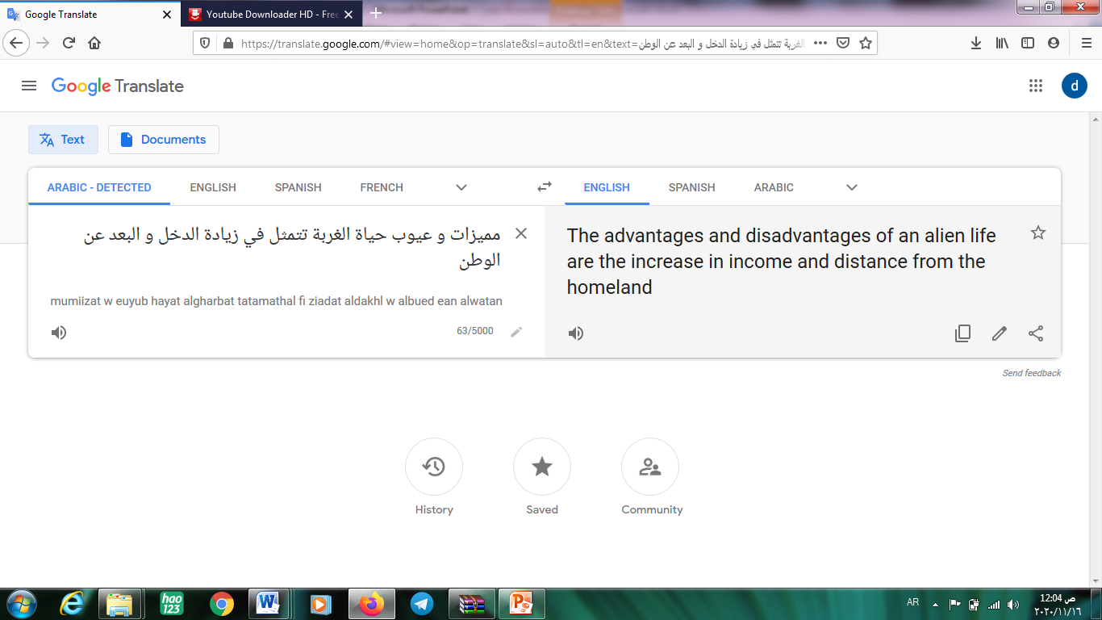

Slide 9
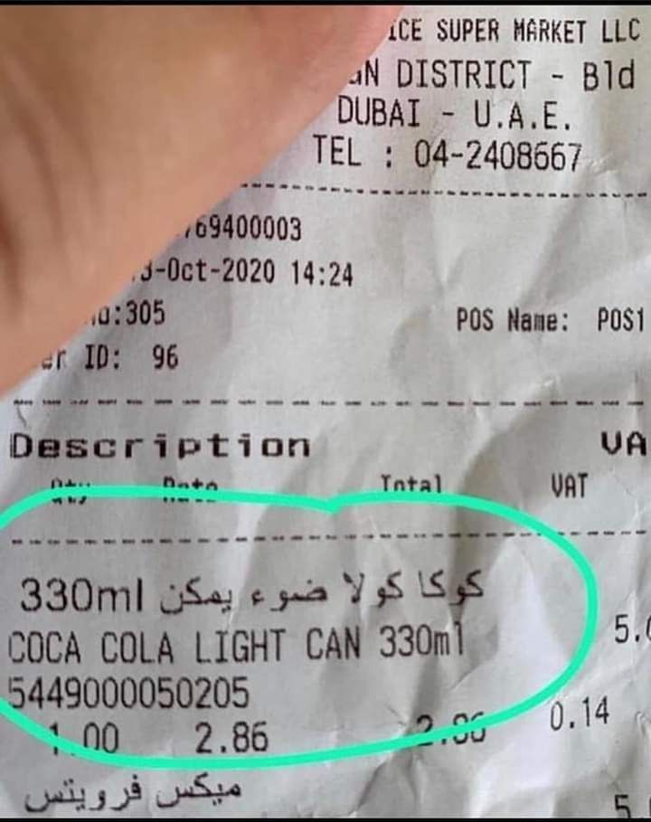

Slide 10
Best suited for: Getting the general idea of what a text says.
Note:
This method should never be relied on when high accuracy and/or good quality wording is needed.

